Slide 1


DEPLOYING
Internet and Intranet Firewalls
A Virtual Instructor-led Course Designed Specifically for FDIC Risk Management Examiners

Slide 2
An Important Resource
Ideally you have already visited: https://class.hillvt.com/
and found the page corresponding to our class
If not, please do that now, and bookmark that page
We’ll put various things there for use during class
We use this site for file and knowledge sharing
Nothing there is:
Required or mandatory, just maybe useful
Secret or confidential to FDIC or anyone else
It will disappear soon
We’ll leave it up for a week or so after class, so no real rush, but save what you want to keep.

Slide 3
Why we’re here this week
Is to begin cracking this code!
In a diagram like this, there’s lots of security stuff. What is it all?
Why all the brick walls? What do they mean or imply?
What are DMZs, UTM boxes, VPN endpoints, and gateways?
Clouds just mean “internet here” right?
Can some routers also be firewalls? Can some firewalls route?
Lines imply “separate” networks, but what does that mean?
How can a bank’s firewall prevent phishing or ransomware or …?
How can information like this help me identify risk?
Firewalls are only the beginning of a very deep security topic
Be aware that we’re just scratching the surface this week
We will depart from the materials considerably to do this.

Slide 4
Hi, I’m Matt
We have 15 hours together this week. I’ll go first:
My name is Matt Kolon, I’m a Senior MTS at Hill Associates
I’m a long-time networking, telecom, and security nerd
I’ve worked for Cisco, Juniper, and Brocade as well as Hill
From 2005 to 2017 I lived in 香港, 北京, and 東京
Now I live in Underhill, Vermont where I ski and ride bikes a lot
It sounds like I’m pandering, but the FDIC is truly my favorite customer! I’m very happy to be with you this week.
In prior lives I had many bank and regulatory customers
I spent a few years in the Reston / Herndon, VA area on various agency and other government contracts
Projects ranged from engineering to policy to consulting

Slide 5

Introductions
Now it’s your turn:
Name and location
Function or position: Risk Management Examiner? IT Examiner? S&S? Something else?
Any experience in cybersecurity topics?
What would you like to learn this week?

Slide 6
Putting Information Technology in Perspective
The FDIC’s Role
The Bank’s Role
Information Technology Examiner (ITE) and/or Risk Management Examiner (RME) examines the bank
How well did the bank perform its Information Technology tasks?
RME: High-level assessment
ITE: Detailed assessment
Ask important, relevant questions at both levels of detail
Information Technology risk is an operational risk
The bank is responsible for
Information Security
Information Technology Risk Assessment
Information Technology Audit
Business Continuity and Disaster Recovery Planning
The Information Technology Officer’s Questionnaire is the examiner’s starting point

Slide 7

Objectives
FDIC Technology Supervision Branch—IT Section, sponsor of the program, expects the following topics to be covered
A solid introduction to key topics relating to security principles of firewalls
Essential baseline terminology and concepts relating to key topics of Internet and Intranet Security threats
In accordance with the Federal Financial Institutions Examination Council (FFIEC ) IT handbook and its applications
And relevance to the world today, especially with regard to implementation and management of firewalls

Slide 8

Overall Goals
Understand basic firewall concepts and apply them to banking situations
Identify the technology behind, and function of, various competitive firewall products and solutions offered in the industry
Gain an understanding of the underlying relationships between interconnecting concepts related to firewalls, threats, and information security
Answer two questions
How does this stuff work?
How does it relate to a bank examination?
Challenge/change/reaffirm your thinking

Slide 9
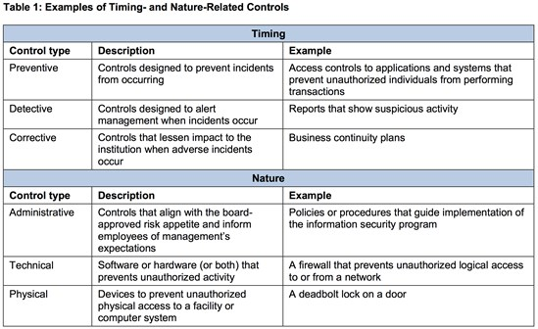
Firewalls as Controls
Firewalls can serve as both timing- and nature-related technical controls
FFIEC suggests a “layered control system” and we have one right here!
Clearly “firewall” means many different things
Notes:
"Important, relevant questions"

Slide 10
What does the FFIEC say?
Under Security Operations, the Information Security Booklet assigns important responsibilities to Firewalls and related devices and functions:
Threat Identification and Assessment
Threat Monitoring
Incident Identification and Assessment
Incident Response
https://ithandbook.ffiec.gov/it-booklets/information-security/iii-security-operations/
These roles are an important framework for us this week!

Slide 11

Agenda
Monday
Introduction, orientation, and program goals.
Review of TCP/IP and networking.
Firewall functions and technologies.
Tuesday
Types of vulnerabilities, attacks and breaches.
Monitoring firewall and security functions.
Firewall management and administration.
Incident response and forensics.
Wednesday
Financial institution network security design.
Management oversight.
Banking firewall review and knowledge check.
Firewall Questions and Controls Exercise
Find a Firewall Exercise
Firewall Topologies Exercise

Slide 12

Reviews and Exercises
We do a morning review of the previous day’s materials
Bring any questions to class each morning
Group exercises augment learning and knowledge, so we have three this week:
Firewall Questions and Controls
Find a FinSec Firewall
Firewall Topologies
If possible or specifically requested, we have another exercise possibility:
Next-gen security technologies

Slide 13

Classroom Ops
Class runs 11-5 Eastern time each day
We’ll take a 60-minute break around 1pm, and shorter breaks near the top of each hour
Please limit distractions and stay tuned in
If you need to leave/disconnect/drop, do so quietly
Check with FDIC class admin regarding significant absences, they determine class credit
Any specific products/services mentioned are meant as examples, not endorsements
Matt has worked for Juniper, Cisco, and Broadcom in the past, but has no ties to or investments in them now

Slide 14

Financial Security Predictions for 2025
Good old Phishing and Social Engineering
As always, people remain the weakest link
Ransomware remains in the news, at banks and otherwise
Remote workers are still everywhere, even in small banks
New technologies carry new threats
AI, SD-WAN, Core services VPNs, cryptocurrencies, 5G, new payment systems, new clouds
Credential Stuffing
There are lots of credentials for sale on the dark web
Resurgence of DDoS as an attack type!
Internet of Things (IoT) = more threats via devices
Cameras, cars, fridges, security systems, wearables
Governance and Regulation Transformation
Threats evolving faster than reactions ever could
How will smaller banks even begin to cope?
?

Slide 15
What are *your* predictions?
Anything else in the news?
Trends you expect to accelerate?
Will international instability affect US banking?
Is AI going to supercharge fraud?
Any big political events coming up this year?
Gee, I wonder
Business and/or Financial happenings that could affect community banks or smaller institutions?
What worries you about network or data security?
What’s the thing you don’t want to hear on your next examination?

Slide 16
Cybersecurity Fundamentals
Chapter 2

Slide 17

Objectives
Upon completing this chapter, you will be able to
Identify the layers of the TCP/IP protocol suite
Differentiate between the responsibilities of the different layers with respect to firewalls and security
Describe various address and port spaces
Describe the process of routing and forwarding
Describe the process of error detection and correction
Understand how configuration information is distributed to connected devices

Slide 18






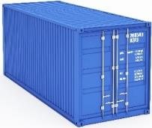
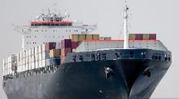
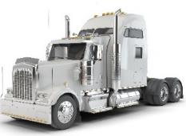
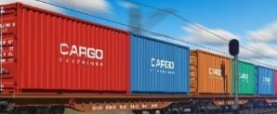



How Internetworks Work—An Analogy
Something to be Shipped
Break it up for Transport
Forward Containers Between Locations
Containers Ride in Various Vehicles
Vehicles Ride over Various Media

Slide 19





Applying the Analogy
Something to be Sent
Something to be Shipped
Break it up for Shipping
Break it up for Sending
Route Containers Between Locations
Forward Packets Across Internetwork
PACKET
PACKET
PACKET
Carry Packets Over Each Network
Containers Ride in Various Vehicles
DOCSIS
Wi-Fi
Ethernet
Vehicles Ride over Various Media
Various Media in Each Network
Coax
Radio
UTP
Fiber

Slide 20
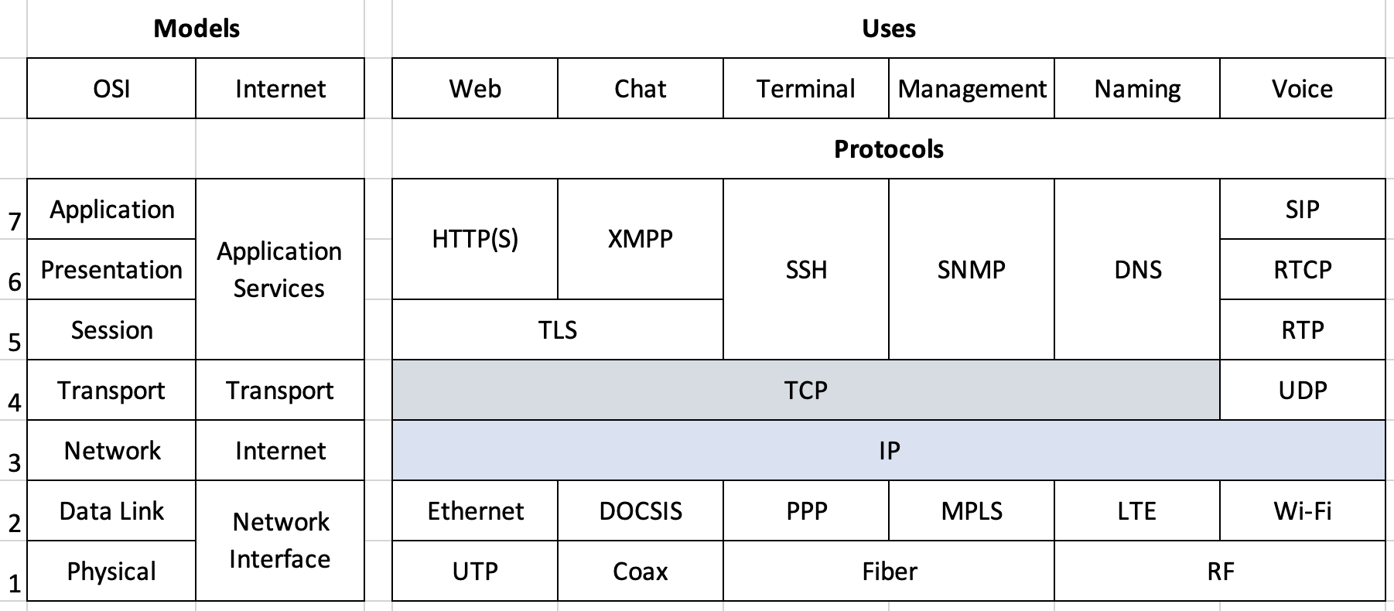
Models and the TCP/IP Protocol Stack
This is a summary view of a very detailed topic. It’s mostly correct but not even close to comprehensive. Quibbles could go on forever!
The framework is what’s important, we’ll give specific details later.

Slide 21
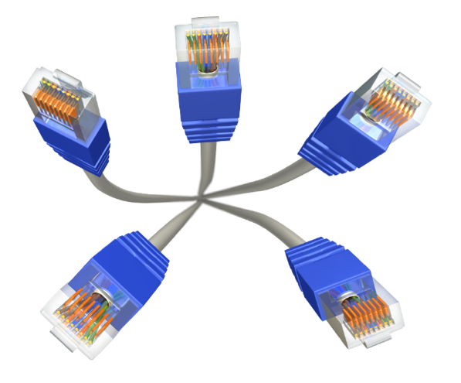
At the Bottom: The Network Interface Layer
Moving bits across a physical path
Speed and distance
Physical media
Cables
Fiber, Coax, Twisted pair
Wireless
WiFi, Bluetooth, Cellular
Media access control
Controlling priority
Basic error checking (typically no correction)
Ethernet, PPP, DOCSIS
Transport mechanism
Significant in handling throughput
Not significant in the world of firewalls other than capacity

Slide 22
The Network Interface Frame
The informational unit of the network interface layer
Contains the packet from the layer above
Header contains the “hardware address” (MAC address) for the physical interface to recognize
For Ethernet the address is “burned in” by manufacturer
Globally unique (but can be spoofed)
Trailer has basic error detection information (e.g., CRC)
Frame
IP Packet
Header
CRC

Slide 23

Identifying Addresses
C:\Users\carl>ipconfig /all
Windows IP Configuration
Host Name . . . . . . . . . . . . : WC-HY63VV3
Primary Dns Suffix . . . . . . . :
Node Type . . . . . . . . . . . . : Hybrid
IP Routing Enabled. . . . . . . . : No
WINS Proxy Enabled. . . . . . . . : No
U
Wireless LAN adapter Wi-Fi:
Connection-specific DNS Suffix . :
Description . . . . . . . . . . . : Intel(R) Wi-Fi 6E AX211 160MHz
Physical Address. . . . . . . . . : 64-49-7D-B6-D1-D1
DHCP Enabled. . . . . . . . . . . : Yes
Autoconfiguration Enabled . . . . : Yes
Link-local IPv6 Address . . . . . : fe80::a7d:5d95:340f:f819%8(Preferred)
IPv4 Address. . . . . . . . . . . : 192.168.60.195(Preferred)
Subnet Mask . . . . . . . . . . . : 255.255.255.0
Lease Obtained. . . . . . . . . . : Wednesday, November 15, 2023 1:01:47 PM
Lease Expires . . . . . . . . . . : Wednesday, November 15, 2023 2:01:47 PM
Default Gateway . . . . . . . . . : 192.168.60.1
DHCP Server . . . . . . . . . . . : 192.168.60.1
DHCPv6 IAID . . . . . . . . . . . : 90458493
DHCPv6 Client DUID. . . . . . . . : 00-01-00-01-2B-D9-0D-5D-0C-37-96-4A-79-E9
DNS Servers . . . . . . . . . . . : 192.168.60.1
Check your own computer
What do you see?
What interfaces appear?
How many are there?

Slide 24
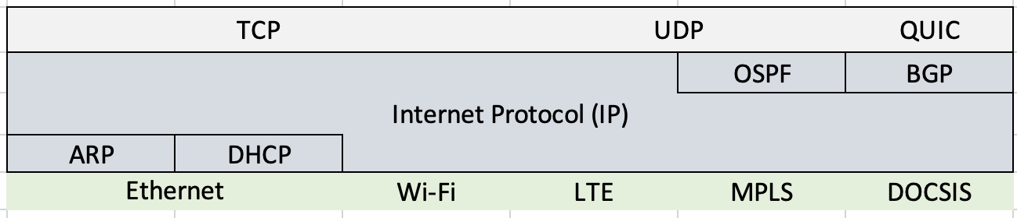
The Internet Layer
IP is the center of the internet. It’s involved in just about everything.
OSPF and BGP are two protocols used by routers to share network reachability information. There are other routing protocols too.
ARP and DHCP are IP “helper” protocols
ARP (Address Resolution Protocol) relates MAC addresses to IP addresses
DHCP (Dynamic Host Configuration Protocol) is used to give clients their IP addresses and other information they need to communicate

Slide 25
Internet Layer Role
IP defines the connectionless, best effort service
Connectionless—“unreliable”
Best effort—no guarantees
Two versions in play today IPv4 (dominant), IPv6 (the replacement)
Routing end-to-end across a global network
Using global configured addresses to route packets
An IP packet is an IP header plus a transport layer segment
Packet
Transport Segment
Header

Slide 26
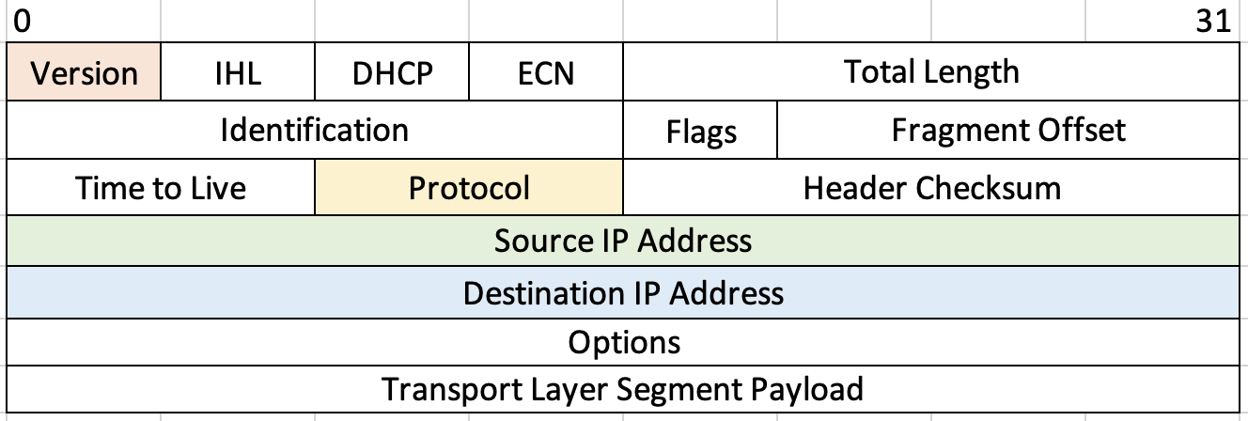
IPv4 Header
Many interesting things here, but most important to us are the version, protocol, and address fields
Version is either 4 or 6 indicating the version of IP that follows
Protocol is a code for what’s in the payload. 6=TCP, 17=UDP, 1=ICMP (used to “ping” something to check if you can reach it)
Addresses are the fun part!

Slide 27
IPv4 Address
32 binary digits (bits) long
Represented in dotted decimal notation (for us humans)
Hierarchical structure
Like your phone number (area code + phone number)
Two parts: Network Identifier (NETID) + Host Identifier (HOSTID)
But unlike a phone number, there is no fixed format. The line between NETID and HOSTID can be anywhere! What to do?
10000000
01000011
00100110
00010111
= 128.67.38.23
NETID
HOSTID

Slide 28
Subnet Masks
Subnet masks are all over network diagrams. A few points:
Addresses are always assigned with their network mask:
The mask defines the split between NETID and HOSTID.
A newer, better, easier way to say this is with “slash” notation:
We see both types of notation in the field
Either way, this is clearly HOST 23 on NET 128.67.38.0
That’s it! Now you know about subnet masks!
10000000 01000011 00100110 00010111 = 128. 67. 38.23 (Address)
11111111 11111111 11111111 00000000 = 255.255.255. 0 (Mask)
NETID
HOSTID
10000000 01000011 00100110 00010111 = 128.67.38.23/24
NETID
HOSTID
Length of NETID

Slide 29

Subnetting and Supernetting/Aggregation
The subnet mask determines how many bits of the address represent the network
Adding more “ones” in the subnet mask makes more networks possible; each network will have fewer hosts
Having fewer “ones” in the subnet mask means an address can represent multiple networks
Routers and firewalls use this to summarize
191.1.1.0/24
191.1.2.0/24
I don’t care, it’s all 191.1/16 to me!
191.1.0.0/16
191.1.3.128/25
Rest of the Internet
191.1.3.0/25
And so on…
Us too!

Slide 30
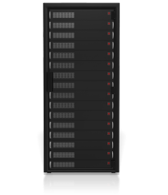
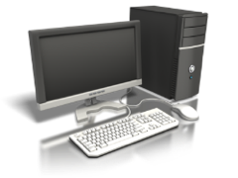
Hosts, Routers, and IPv4 Addresses
LAN (199.182.20.0/24)
WAN 142.100.0.0/16
199.182.20.17
199.182.20.5
142.100.62.101
Host
199.182.20.100
142.100.84.215
142.100.81.54
199.15.12.35
All stations attached to a subnetwork share a common subnetwork address
Routers (and firewalls) have multiple addresses
IP addresses are assigned per interface and not per device
199.15.12.0/24
199.15.12.5
Host

Slide 31
IP Address Assignment with DHCP
DHCP dynamically assigns address from a pool of addresses
Ideal for roaming systems, but in common use for clients everywhere
Three address allocation mechanisms
Automatic
Dynamic
Manual
Servers and routers should not be DHCP clients
They need to be consistent and easily found, so therefore usually have statically assigned addresses.
DHCP can also provide other information, and usually does:
Local router (so-called “default gateway”)
Local DNS server address
Sometimes OS settings stuff (Windows servers, etc.)

Slide 32
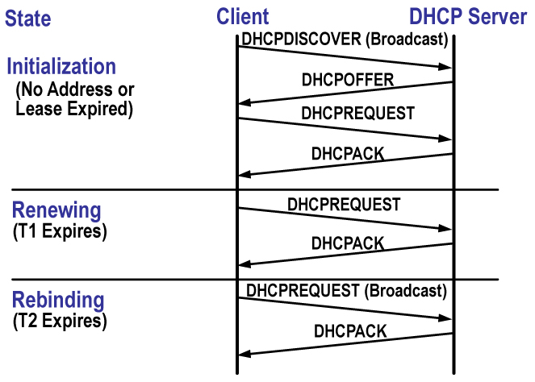
DHCP Dynamic Address Assignment
What if this exchange of information was interrupted or compromised?

Slide 33

Private Address Space and NAT
There are three address ranges reserved for use by private* networks
Class A (10/8), Class B (172.16/12), and Class C (192.168/16)
These can’t exist (be routed to) on the “open” internet
They are nevertheless used for almost every internet client through the magic of Network Address Translation
Internet
123.231.22.11
Bank’s ISP
123.231.0.0/16
192.168.1.1/24
NAT
* meaning “belonging to a single non-provider entity,” not “safe from prying eyes.”

Slide 34

The Role of a Router
128.12.4.1
128.17.5.1
128.12.3.4
128.12.5.15
126.17.5.14
128.17.5.15
Subnetwork 128.12.0.0/16
Subnetwork 128.17.5.0/24
Routers have multiple interfaces, each with its own address
Each interface’s NETID is the same as all other devices on that network
Their HOSTIDs of course, are different
Router duties include:
Forwarding packets towards the destination network
Talking to other routers to learn about remote networks

Slide 35
The Routing Protocol

Slide 36
Address Resolution Protocol
Notes:
Arp pi

Slide 37
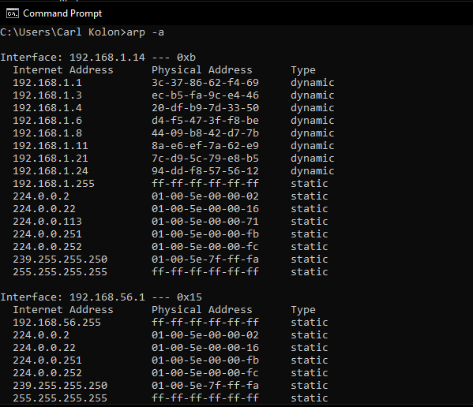
Windows arp Command
Displays and modifies the IP-to-Physical address translation tables
The use of switches modifies the command
arp –a displays the arp table
arp –s to set a translation
arp –d to delete a translation
Notes:
Arp –a for mac too

Slide 38
The Transport Layer

Slide 39
Transport Layer Role
End-to-end, messages. Optional error correction.
Multiplexing, meaning used for many applications
Can be connection oriented or connectionless
Connection establishment/release if required
Flow control, speed up, or slow down if losing information
Error recovery, usually retransmit lost or damaged information
Segmentation and reassembly, putting large data into manageable packets
Segment
Application Data
Header

Slide 40
Transmission Control Protocol (TCP)

Slide 41
TCP Error Correction
Establishes a connection using a three-way handshake
SYN
SYN, ACK
ACK
Sequence numbers and transmit and receive buffers are allocated
The TCP sender transmits each segment with a sequence number and increments it based on the number of bytes sent
The TCP receiver responds with an ACK indicating the latest sequence number received
If the sender doesn’t hear back from the receiver then will transmit again
This process also governs how fast information is transferred
TCP provides high reliability that all information is received, unlike UDP which just transmits, (no acknowledgements)

Slide 42
User Datagram Protocol (UDP)
0
1
2
3
0
1
2
3
4
5
6
7
8
9
0
1
2
3
4
5
6
7
8
9
0
1
2
3
4
5
6
7
8
9
0
1
Source Port
Destination Port
Length
Checksum
Data
Best-effort service, no error detection or correction.
Low overhead
No connection process (like the TCP sync), just send data
Can be used to flood traffic in a DDoS attack

Slide 43
Well-Known TCP/UDP Ports
Port identifies application layer protocol
Firewalls can identify if an application is allowed
Port | Protocol | Port Name (Function)
20 | TCP | ftp-data (File Transfer Protocol data channel)
21 | TCP | ftp (File Transfer Protocol control channel)
22 | TCP | ssh (Secure Shell Protocol)
23 | TCP | Telnet
25 | TCP | smtp (Simple Mail Transfer Protocol)
53 | TCP; UDP | domain (Domain Name System information)
69 | UDP | tftp (Trivial File Transfer Protocol)
80 | TCP | http (HyperText Transfer Protocol)
110 | TCP | pop3 (Post Office Protocol)
119 | TCP | nntp (Network News Transfer Protocol)
123 | TCP | ntp (Network Time Protocol)
143 | TCP | imap4 (Internet Message Access Protocol)
161 | TCP | snmp (Simple Network Management Protocol)
443 | TCP | https (HyperText Transfer Protocol Secure)

Slide 44
Sockets

Slide 45
Windows netstat Command
Like most operating systems, Windows has a ‘netstat’ command.
Displays protocol statistics and current TCP/IP network connections
Important ones
No switch (active connections)
a (all connections and listening ports)
r (routing table) [“route print” achieves same]
n (additional switch to display in numerical form)
s (per-protocol statistics)
e (interface statistics)
You may be surprised at the number of conversations your computer is having at one time

Slide 46
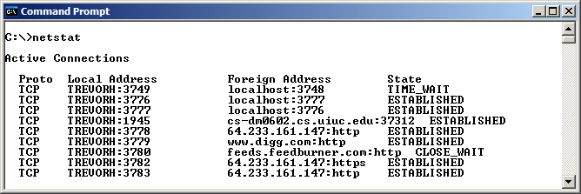
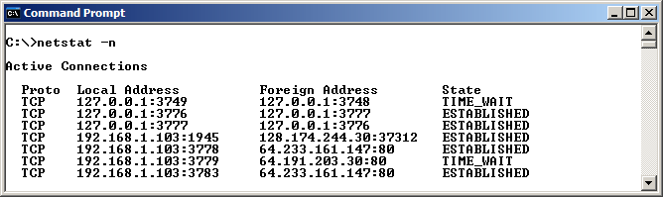
Netstat: Active Connections

Slide 47
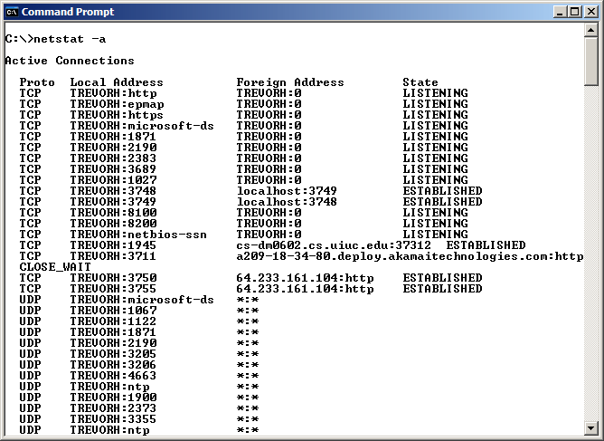
Netstat: Active and Listening

Slide 48
Application Services Layer

Slide 49
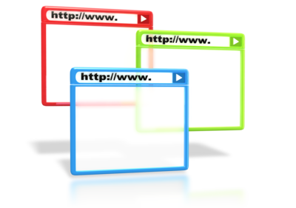


Application Services Layer Role
Interface to network-wide services
Identify communication partner by name or address
System-independent services to end-user
Understand and establish resources required to communicate
HTTP, FTP, DNS, SNMP, SMTP…

Slide 50
Servers and Listening Ports
SMTP Request
A client starts the communication
A server responds to a request
Requests for multiple services to a single server possible
Each request initiates a transport session
The server listens for a request on a specific port to know which application to activate
A client creates a new port for the conversation to know which server is responding
Passive listening on potentially multiple ports
HTTP Request
FTP Request
Client
Server

Slide 51

Is Your Computer a Client or a Server?
The answer will be different depending on your point of view
Also depends on the applications and protocols in use
Run netstat and see what the connections indicate
How does this pose a threat?
How could a firewall help?

Slide 52
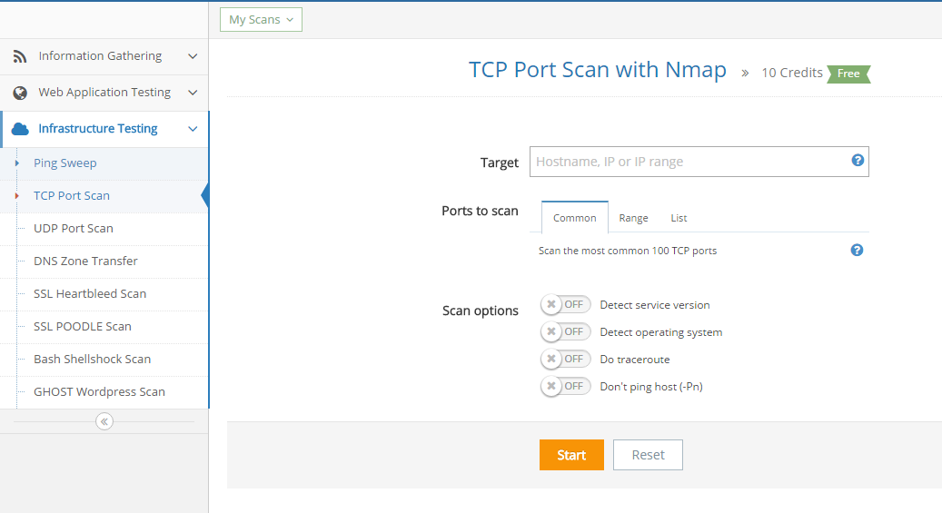
Scanning for Listening Ports
Many tools available for download
Also as an online tool (e.g., pentest-tools.com)

Slide 53
Review Questions
What could a hacker do after obtaining access to bank traffic?
What elements of the IP protocol suite can you imagine being useful to someone wanting to disrupt or otherwise compromise a bank?
How could the protocols themselves be used to safeguard things?
Can you imagine any ways that changes in protocols could help solve today’s security issues? What are they?

Slide 54

Summary
Identified the layers of the TCP/IP protocol suite
Differentiated between the responsibilities of the different layers
Described the IP address space (IPv4 and IPv6)
Identified the different addresses used in the different layers
Described the process of routing and forwarding
Described the process of error detection and correction

Slide 55
Firewall Functions and Technologies
Chapter 3

Slide 56
Objectives
Upon completing this chapter, you will be able to
Discuss four fundamental firewall operations and their role in cybersecurity
Describe Unified Threat Management
Understand some elements of EDR, XDR, SOAR, and other modern security solutions

Slide 57

Traditional Firewall Overview
Outside Security Zone 1
Blocks or permits traffic
based on a set of rules
In the VPN course, we learn how outmoded – yet persistent – this “zone” way of thinking is.
“Outside” no longer means “untrusted” and “inside” is no guarantee of trust.
Inside
Security Zone 2

Slide 58

Why Use a Firewall?
Provide a network control point
Establish different security zones
Limit access to sensitive data
Meet compliance requirements
Protection from litigation
Gather statistics on network usage
Block unauthorized types of traffic
Limit transfers to known safe locations

Slide 59
What Firewalls don’t do
Traditionally, firewalls controlled only network traffic
We’ll shortly examine how these functions work
Because today’s firewalls are software-defined, they:
Often incorporate functions formerly to other devices
IDP/IDS, VPN, Anti-[spam, malware, virus], compression, DLP
Themselves integrate into overall security architectures
But even enhanced firewalls or UTM devices can’t
Stop ill intent
Help against many internal threats
Address many things on the FFIEC Security Operations list

Slide 60
Firewall Technology Models

Slide 61
Packet Filtering
Basic firewall feature
Usually implemented in the router
Treats each packet independently
Filters based on source and destination addresses (IP and Port)
For example:
filter all outbound private IP addresses

Slide 62
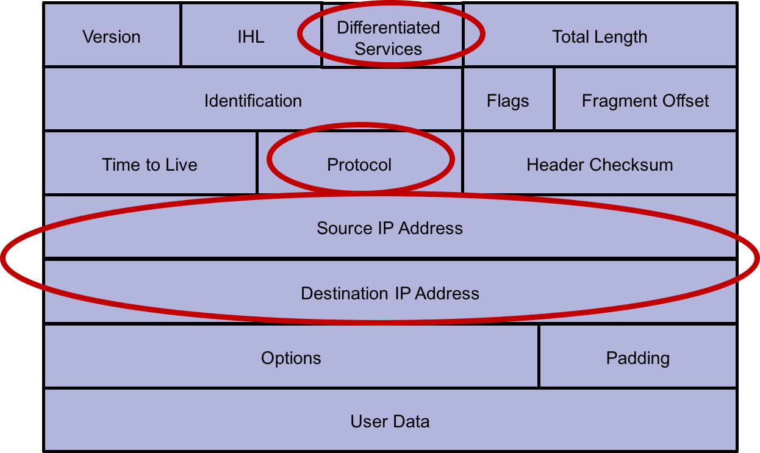
IP Header Filters

Slide 63
Packet Filtering Review
Advantages
Challenges
Simplistic
Unaware of packet payload
Lacks state
Susceptible to IP spoofing
Difficult to create rules (order of precedence)
Low impact on network performance
Low cost

Slide 64
Stateful Inspection
Improves on packet filters
Tracks the state connections for TCP and other protocols
TCP connections can be in three states
Connection establishment
Established
Termination
Connectionless UDP still follows protocol sequence, e.g., a DNS response is always preceded by a DNS query
State table tracks the status/state of connections

Slide 65
Sample Connection State Table
Source Address | Source Port | Destination Address | Destination Port | Connection State
10.0.1.50 | 1024 | 13.107.7.190 | 25 | Established
10.0.1.67 | 1025 | 173.194.207.101 | 80 | Initiated
10.0.1.50 | 1030 | 173.194.207.101 | 80 | Established
10.0.1.100 | 1033 | 173.252.90.132 | 443 | Established

Slide 66
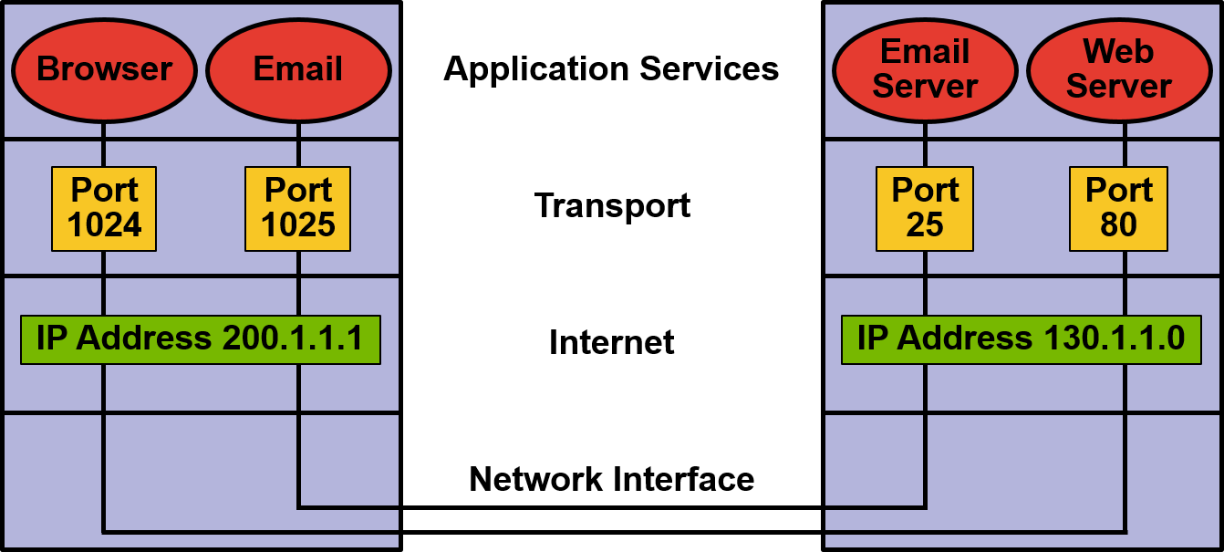
Remember the Socket

Slide 67
Stateful Inspection Review
Advantages
Challenges
Low to moderate impact on network performance
Only allows legitimate connection data through
Higher level of security than a packet filter
Shares many of the same negative issues associated with packet filters
Allows any data to simply pass through the connection once established
Only provides for a low to moderate level of security

Slide 68
(Web) Application Firewall
Deeper inspection of the packet
Understands how the protocols should work
Analyzes activity to ensure protocol sequences are normal and any application specific rules are followed
For example
Multipurpose Internet Mail Extensions (MIME)
Allows for email attachments
Application Firewall rule might exclude .exe attachments
Any such attachment would be blocked at the firewall

Slide 69
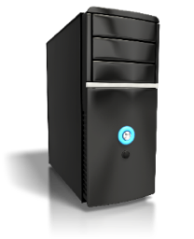
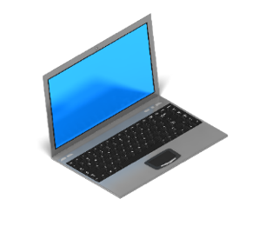
Application Proxy Gateway
Two
Connections

Slide 70
Application Proxy Review
Advantages
Challenges
Intermediary between the client and server
Allows for thorough inspection of application content
Ability to identify complex multi-threaded threats
Can be CPU and memory intensive
May need constant update of threat analysis
Complex to configure
Expensive

Slide 71

Virtual Private Networking
Often a function of the firewall
Two main types of VPN
Remote access
Site-to site
Most commonly used protocols
IPSec
SSL
Adds additional CPU and memory requirements to the firewall
May up the model to meet throughput requirements ($)
May be used for
Service provider connection
Branch network
Mini-branches

Slide 72
Network Access Control
Integrated into the firewall
Checks current configuration of remote machine
Software patch level
Anti-malware status
Last updates

Slide 73
Unified Threat Management

Slide 74
UTM Functions
Packet filter
Stateful inspection
Application firewall
Advanced malware detection
Content filtering
IPS/IDS
UTM
Appliance

Slide 75
UTM the New Norm
Integrates multiple security functions
Advanced threat analysis
Policy controls
Applications
Users
Content
Network and endpoint security
Appliance and cloud driven
Next Generation Firewall

Slide 76
UTM Review
Advantages
Challenges
Integrates multiple functions into one device
Simplifies configuration and management
Cloud or cloud plus appliance maintains currency
Reliance on one vendor
Integrates multiple functions n one device
Potential single point of failure
Expensive, but less than point solutions

Slide 77
Firewall Technologies Review

Slide 78
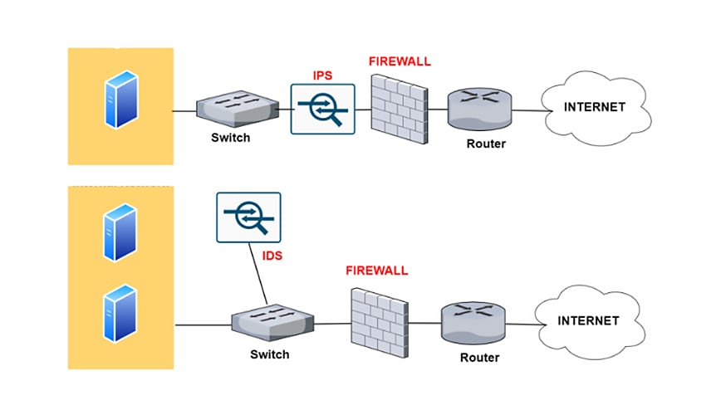
IDP/IDS
Intrusion Prevention / Detection
Often integrated with, or connected to, firewall/UTM functions
Detection based on signatures and protocol behavior
Many vendor-unique solution components and names
Attack signatures must be kept current
Sometimes requires software license

Slide 79
EDR, XDR, SOAR, and more...
There are many new and advanced cybersecurity solutions that extend beyond what firewalls can do alone
They are often combined with firewalls into a broader system
Endpoint Detection and Response (EDR) focuses on protecting endpoints like computers, mobile devices, and servers, by continuously monitoring them for suspicious activities
Extended Detection and Response (XDR) extends beyond endpoints to provide a more comprehensive security solution by integrating various security products and their respective data sources.
Security Orchestration, Automation, and Response (SOAR) is designed to streamline security operations in a holistic and automated manner.
We’ll see more about these and other tech in an exercise later

Slide 80
Summary
Discussed four types of firewall and their operation
Described Unified Threat Management
Had a brief look at some new, advanced, security solutions

Slide 81
Exercise: Firewall Questions and Controls
Using the “Firewalls as Bank Network Controls” slide as a framework, work with your group to develop:
Five Questions pertaining to firewalls/UTM you might ask at your next bank examination.
Good and less-good answers to your questions
These can be as technical as you’d like, but the best questions about topics like this are usually not.
Don’t think: “What ports are open on your firewall?”
Instead perhaps: “How do you ensure your firewall only passes legitimate traffic?” and “What is that legitimate traffic?”
This type of approach helps avoid techno-babble confusion.

Slide 82
Firewalls as Bank Network Controls
FFIEC and others consider firewalls a type of control
But as we’ve seen, “firewall” is a very vague term
A firewall is more like a “controller of controls”
Firewalls can and do influence all these controls, and more:
Packet filters (ACLs, rulesets)
Application policies
Protocol state
Traffic logs
Physical and virtual location
Addresses and ports
Remote access
Traffic types
DNS trickery
Availability

Slide 83
Exercise: Find us a FinSec Firewall
Each table will investigate a firewall from a major vendor.
You’re looking to secure a small bank with 1 HQ and 2 branches.
One 1 Gb Internet connection to HQ, shared via Ethernet WAN to branches.
DMZ for public web server.
Things you’re concerned with:
Cost (related to the box you choose!)
Ease of use
Comprehensiveness of solution
Types of threats protected against
Ability to reconfigure flexibly
Investment Protection
Cloud readiness
Room to grow/expand
Companies to Consider:
1: Fortinet
2: Palo Alto
3: SonicWall
4: Barracuda
5: Cisco

Slide 84
Exercise: Find us a FinSec Firewall (cont.)
Questions to ask:
Is this solution a firewall? UTM? NGFW? Something else?
Is it an appliance? Is there a virtual appliance available for the cloud?
Is there a service associated with it to identify threats and update a threat database?
Does this manufacturer identify Financial entities or FinTech as a target vertical?
Do they have specific financial industry solutions available?
Are there case studies or other documents available in the financial area?
Is there anything else of interest to banks?
Companies to Consider:
1: Fortinet
2: Palo Alto
3: SonicWall
4: Barracuda
5: Cisco

Slide 85
Exercise Debrief
Make a single slide that reviews:
Pros and cons of the company, platform, approach, product?
Ideas about the changes required to implement it?
Plans for maintenance and upkeep?
Thoughts about what else should be considered to keep the bank network safe? Did you feel there were important things missing?
Other considerations or thoughts?
No pressure here, the “slide” is just a suggestion. I just would like someone from each team to review what you thought about the assigned platform.

Slide 86
Network Vulnerabilities and Attacks
Chapter 4

Slide 87
Objectives
Understand some types of network vulnerabilities.
Understand a few of the ways networks are used to attack businesses and systems.

Slide 88
Types of Network-centric Attacks
There are many ways to attack a network resource.
Firewalls can help with some, but not all of the problem.
We concentrate on DoS and DDoS because they are:
Very common.
Network-centric.
Easy to execute.
Firewall-addressable.
Applicable to banks and financial institutions.
But the other types are worth some discussion.
Many attacks combine methods.
Attack | Countermeasures
Man-in-the-middle (MitM) attacks | Certificates, Hashing.
Phishing and spear phishing | Education, Sandboxing.
Malware | Anti-virus software, UTM.
Brute-force hacking | Firewalls, whitelisting.
Eavesdropping | Encryption.
Drive-by Attacks | Site patching, UTM.
Password Attacks | 2FA, password policies.
Denial of Service | Firewalls (Next chapter!)

Slide 89
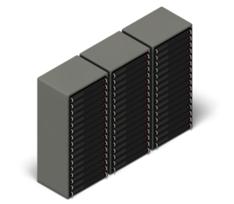


Machine-in-the-middle attacks (MitM)
When a malefactor inserts themselves between two endpoints.
Usually two users or a client and server.
Requires interception of traffic and potentially redirection of session.
Hijacking can occur in real time or later (so-called “replay” attack.)
UTM firewalls, especially with AI, can identify MitM attacks, but the best defense is solid and persistent user authentication, which requires:
Certificates.
End-to-end Encryption
Legitimate Session

Slide 90
Phishing
Phishing is as simple as getting a user to click on a link.
Amazingly, something like 30% of phishing emails are opened.
This is a much better response than legitimate marketing emails!
Really a form of social engineering that exploits reactions.
That link might install software on the user’s browser or client, or cause them to interact with a supposedly legitimate site with the assumption of a private and secure session or conversation.
Imagine the consequences for a bank account holder in this position!
Education is the best defense against phishing, but there is software (on firewalls and clients) that can help identify attacks.
Companies like Sophos, Barracuda, and Fortinet claim solutions.
These usually depend on databases of attack signatures.
New/novel approaches often take time to be identified, no zero-day.

Slide 91
Malware
Malicous Software – installed on your systems without your knowledge or consent and intended to steal data or passwords, or otherwise compromise systems.
Viruses and trojan horses are two of the most famous types of malware, but there are many others, and the threat is constantly evolving. No logic is immune.
Ransomware is a variant that threatens to delete or publish data unless a ransom is paid.
Phishing and worms are malware, but sometimes also used as means of malware distribution.
“Polymorphic” malware changes as it infects, making it difficult to track, follow, and eradicate.
A continually-updated UTM firewall or system is the best defense against malware.

Slide 92
Activity: Malware
How does malware get into the bank?
How can firewalls Help keep it out?

Slide 93

Brute-force Hacking
Systems that aren’t well-secured may be penetrated by:
Manual attempts to connect to open sockets.
Automated port-scanning for script attachment.
Automated password or passphrase guessing.
Exploits of well-known openings in legacy systems.
Bad actors in these hacks aren’t always masterminds.
Many tools for this type of hack are available online for use by even beginner hackers, so-called “script kiddies.”
The largest organizations are usually well-protected, but smaller ones are often users of older, even out-dated, technology that’s more susceptible to BFH.
Not all of these attacks are from outside!
Therefore, tight system security management is a primary defense.

Slide 94
Summary
Described some types of network-based attacks.
Saw some examples of:
MitM.
Phishing.
Malware.
Brute-force hacking.
Understand some countermeasures against attacks.

Slide 95
Distributed Denial of Service (DDoS)
Chapter 5

Slide 96
Objectives
Upon completing this chapter, you will be able to
Describe what a DDoS is
Identify who typically starts a DDoS
Identify who may be at risk
Describe how a DDoS works
Review what approaches are available to mitigate a DDoS

Slide 97

Definition
Denial of Service (DoS)
An interruption in an authorized user's access to a network, servers, applications, or data. Typically it is used with malicious intent through a single attack source.
Distributed Denial of Service (DDoS)
A denial of service that is amplified and appears as multiple attack sources and can have more disastrous results.

Slide 98
Who Initiates DDoS Attacks
Who | Why
Hackers or “Hacktivists” | Publicize a cause Gain a reputation
Criminals | Extort Cover up another attack Financial gain
Governments | Move a nation’s agenda Politics War Espionage
Businesses | Eliminate the competition Impact market reputation
Notes:
FDIC, OCC, and FRB are no longer examining for reputation risk, and remove in the future.

Slide 99

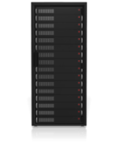

Many Resources Under Attack
Servers
e.g., Layer 7 Attacks slowloris, Request Flood
Internet
Circuit Exhaustion
e.g., UDP Flood
Router CPU
e.g., Frag Attack
Firewall
e.g., Syn Flood

Slide 100
DDoS Attacks
Numbers of attacks are increasing
>2000 attacks per day
Size of attacks are increasing
12 Gbps in single attack
Majority of attacks < 2days
Sophistication of attack are increasing
Multivector attacks
Botnets of millions of bots
Difficulty of initiating attacks is decreasing
<$150 to purchase an attack

Slide 101








Botnets
Infect a computer with malware that allows it to be controlled
Do this to hundreds or thousands of computers
Control all of these by a command and control computer (not necessarily your own)
Initiate a coordinated attack on the desired target. I dunno, a bank?
Attack

Slide 102
Attack Amplification
Increase an attack volume through various reflection exploits
A single message to a server and result in a large amount of data
Spoof the source address of the request to the target
Response data now going to target
Many server exploits available
Network Time Protocol servers
Domain Name System servers
Simple Network Management Protocol devices
Simple Service Discovery Protocol
BitTorrent
Quake Network Protocol
Third Party Server

Slide 103






Example of NTP Amplification
Command and Control 1 computer – 1 attacker Controls a botnet | 1
Botnet 1000 computers Amplification = x1000 | 1000
Botnet runs script at high speed Each computer puts out 1 Mbps of output | 1 Gbps
NTP Devices (1000 or more) Reply to spoofed address with MONLIST information. This example Assumes x100 amplification factor per | 100 Gbps
UDP Flood NTP Source Port 123 | 100 Gbps

Slide 104


Example SYN Flood
Exploits the function of a TCP connection 3 way handshake
Normal operation:
Attack operation:
SYN
From real address
Allocate memory etc.
SYN, ACK
ACK
From spoofed address
SYN
Allocate lots and lots memory etc.
SYN
SYN
SYN

Slide 105
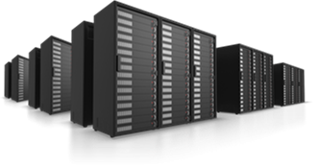
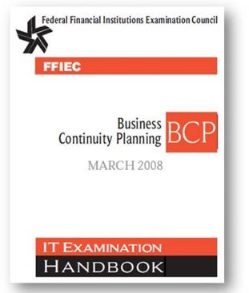
DDoS Has Similar Impacts as Other Threats
Fire
Flood
Earthquake
Hurricane
DDoS
In accordance with FFIEC BCP Handbook and FIL-11-2014

Slide 106
Technology DDoS Mitigation Approaches
On Premises
A security device placed as the first device passed through for Internet traffic entering a customer’s location
Scrub traffic clean
ISP Solution
Arrangement with local ISP to “black hole” traffic during a DDoS attack
Relieve impact on other services
Specialist Cloud Provider
A specialty service that takes all of a customer’s traffic and “scrubs” it to remove the DDoS traffic and then forwards only the good traffic to the customer
Scrubs traffic clean
Hybrid
Combines a cloud service with an on premises service
Scrubs traffic clean

Slide 107
Compare Solutions
High
On Prem
+
Cloud
On
Premises
Price
Cloud
Scrubbing
Cloud
CDN
Do
Nothing
Low
Poor
Performance
Excellent

Slide 108




Implementing Cloud Redirection
For a cloud implemented solution traffic going to victim needs to traverse through the cloud provider
This can be a manual or automatic switch
Mechanisms
BGP routing
Protects the IP address
DNS redirection
Protects the hostname
Still vulnerable to IP attack
Permanent (expensive)
Internet
Scrubbed Clean

Slide 109
Summary
Described what a DDoS is
Identified who typically starts a DDoS
Identified who may be at risk
Described how a DDoS works
Reviewed what approaches are available to mitigate a DDoS

Slide 110
Plan for Wednesday
Review of materials so far, questions, etc...
Monitoring
Administration and Management
Incident Response and Forensics
Bank Firewall Topologies Exercise
A few final grab-bag things
That’s it!
Anything else you’d like to discuss, learn, ask, or otherwise cover? Please say so!
Notes:
INcident Res

Slide 111
Monitoring
Chapter 6

Slide 112
Objectives
Upon completing this chapter, you will be able to
Explain the importance of log management
Identify what we log
Describe how logs can be used
Discuss the importance of Security Incident Event Management

Slide 113
Security Logs
Contain security information
Changes
Access attempts and duration
Suspicious behavior
Many sources for security information
Formats vary
Correlation can help identify danger
Require policies and procedures
What to capture
How to store it
How long to keep it
Where to keep it
How to destroy it
Who can access it
NIST SP 800-92

Slide 114
Who Plays a Role?
Systems and network administrator
Security administrator
Incident response team
Applications developer
Auditor
Application procurement team
CIO

Slide 115
Activity: What to Capture?
IDS
PC OS
Firewall
VPN
Server
Router

Slide 116
Log Uses
Baseline setting
Trends
Auditing
Incident detection
Forensics
Some information is logged continuously, some occasionally.
What might be done continuously?
What might be logged occasionally?

Slide 117
Security Incident Event Management (SIEM)
Centralized automated monitoring
Correlates logs and alarms from multiple sources
Real-time event analysis
Uses event knowledge-base in analysis
Dashboard

Slide 118
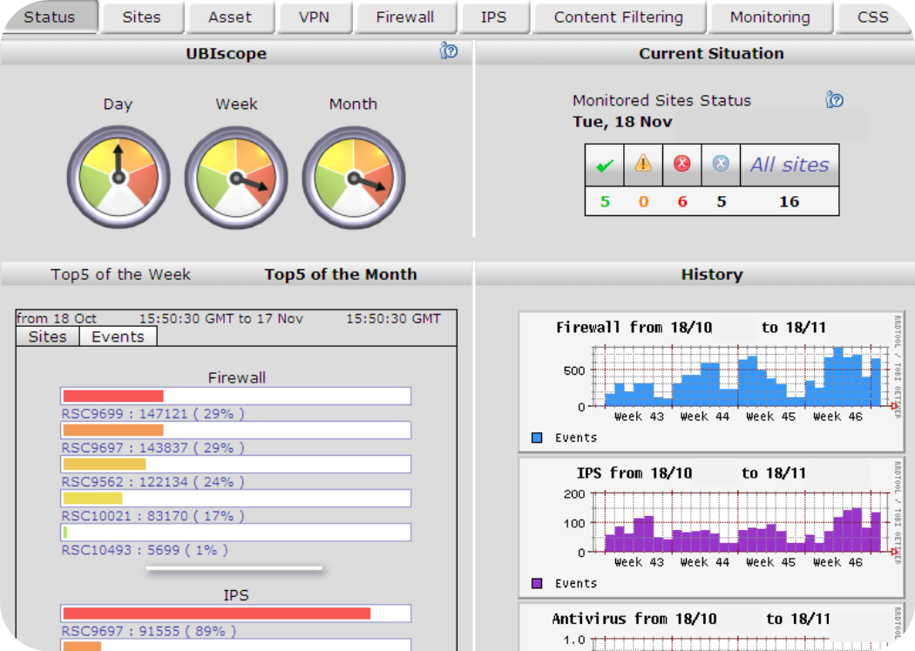
Cisco Smart Operations Service Dashboard

Slide 119
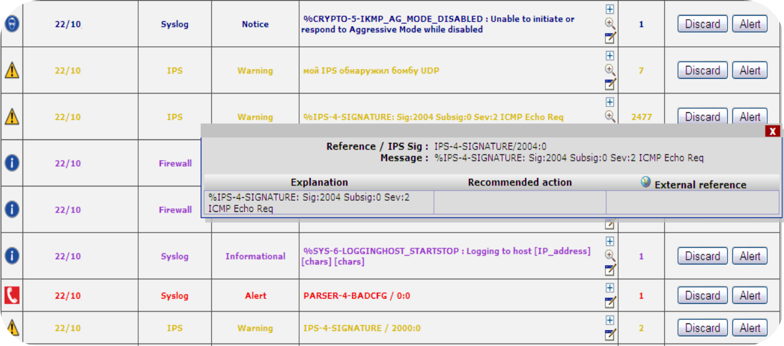
Log Analysis

Slide 120
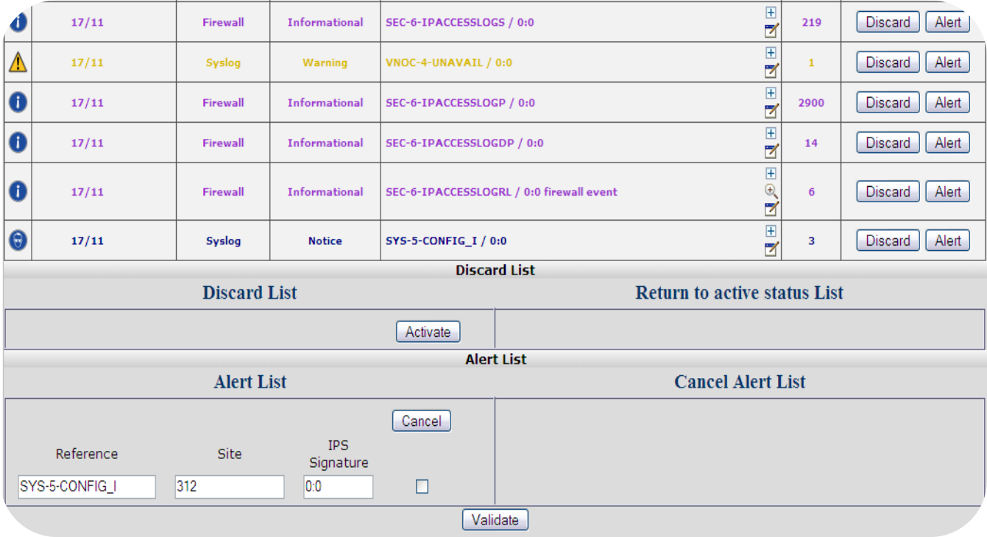
Log Event Management

Slide 121
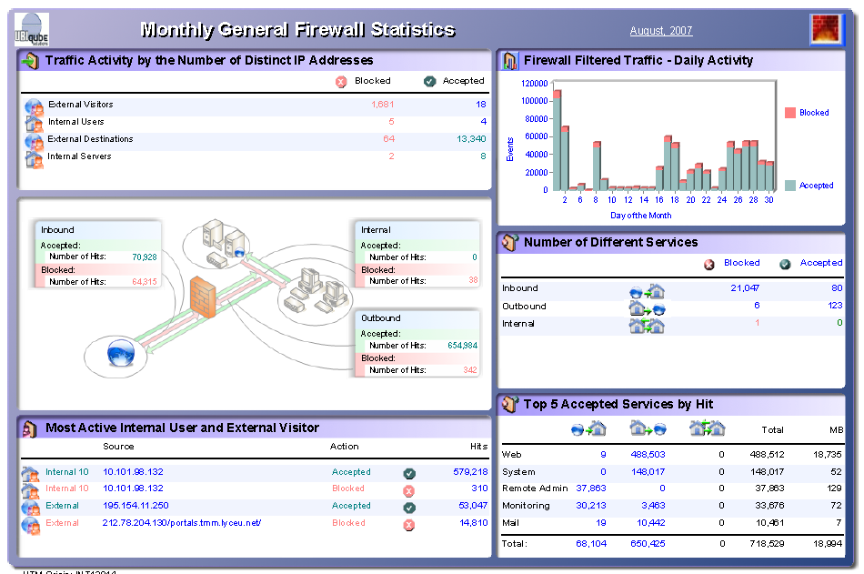
Monthly Reports

Slide 122
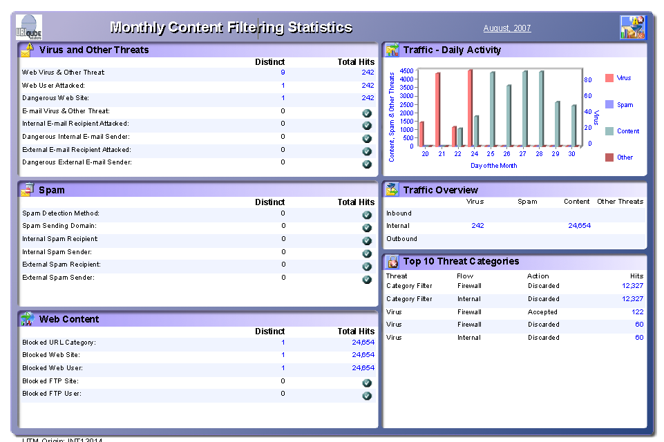
Content Filtering Report

Slide 123
Summary
Explained the importance of log management
Identified what we log
Described how logs can be used
Discussed the importance of Security Incident Event Management

Slide 124
Firewall Administration and Management
Chapter 7

Slide 125
Objectives
Upon completing this chapter, you will be able to
Describe firewall administration requirements
Identify common audit checklist items

Slide 126
Roles
Firewall management and operation requires many roles
Policy development
Procedure creation
Implementation
Monitoring
Incident response
Reporting
Education
Help desk
Update

Slide 127
Roles and Controls
There are many standard controls that need to be in place within an IT organization
Security roles are no different
Controls
Define who has access to security resources
Change access should require additional logon
Password policy
Audit logon attempts
Audit changes
Accounts
Permissions
Configuration

Slide 128
Configuration
External audit should review the firewall configuration
Review controls for developing configurations
Review procedures for managing accounts with firewall access
Check for banner defining the policy
Review backup policy
Ensure backups have been made

Slide 129
Patch Management
Security appliances are no different to any other device
Patch management is critical
Software version, updates, and hot fixes need to be checked for currency
Process for maintaining currency should be defined and implemented

Slide 130

Log and Threat Review
How are security logs reviewed?
Is there a central tool (SIEM) in place?
How often are the logs reviewed?
Do threats generate email warnings?
Who reviews threats?
When does the incident response team get engaged?

Slide 131
Equipment and Configuration
All equipment and configuration should be logged
A standard naming convention should be applied
Log should contain
Name of the equipment
Location of the equipment
Warranty status
Software configuration
User information
Operating system
Applications
Firewall
Notes:
\

Slide 132
Summary
Described firewall administration requirements
Identified common audit checklist items

Slide 133
Incident Response and Forensics
Chapter 8

Slide 134
Objectives
Upon completing this chapter, you will be able to
Describe the key components of incident response
Discuss the integration of forensic analysis into the incident response procedures
Examine two incidents and discuss the response

Slide 135
Incident Response and Management
The Center for Internet Critical Security Controls Incident Response and Management description is to
Protect the organization’s information, as well as its reputation, by developing and implementing an incident response infrastructure (e.g., plans, defined roles, training, communications, and management oversight) for quickly discovering an attack and then effectively containing the damage, eradicating the attacker’s presence, and restoring the integrity of the network and systems.

Slide 136
NIST Incident Response

Slide 137
Preparation
Policy
Create an incident response team
Define roles and responsibilities
Possibly uses internal and external resources
Escalation to senior leadership
Create a call list
Plan
Write the plan
Procedure
Identify potential threats
Prioritize the threats based on likelihood and potential impact
Define incident procedures for those assessed as priorities
Create review process for assessing threats

Slide 138
Incident Response Team Considerations
Personnel selection
Internal versus external versus combination
Skills assessment
Representation from across the organization
Control of sensitive data
Need for legal counsel
Communications list
Customers
Law Enforcement
Vendors (including the ISP)
Employees (including the board)
Regulators
Industry organizations (e.g., FS-ISAC)
Insurance provider
Media

Slide 139
Activity: Threat List
DDoS
Ransomware
Website hacked

Slide 140
Detection and Analysis
Alerts can come from many sources
Too many and they are ignored
Too few and you may not be prepared (assumed low risk)
Detection may require further analysis
Analysis
Understand normal
Tools
Review logs
Utilize resources (google, FS-ISAC)
On detection
Implement the plan
Document the incident response
Preserve data for forensic analysis

Slide 141
Containment, Eradication, and Recovery
Isolate the infected resource
Determine the damage inflicted
Identify what evidence needs to be preserved
Assess what is need to restore functionality
Identify resource requirements
Estimate time to restoration
Gather evidence
Log evidence (time, source etc.)
Recovery (restoration)
Patching
Updates
Replacement

Slide 142
Post-Incident Activities
Document
For larger incidents
Use to maintain record of the incident
Basis for updating approaches
Protection
Detection
Response
Evidence retention
Prosecution
Assess the cost
Share and report
FS-ISAC
Others as needed

Slide 143
Document
What happened?
When?
How well did the plan work?
What could be done differently?
What can be done to prevent future incidents?

Slide 144
DDoS Attack Detection and Analysis
How do we detect an attack?
Calls from
customers
that cannot
get to the
website
Notification from
DDoS
provider
Alarms
from the
router

Slide 145
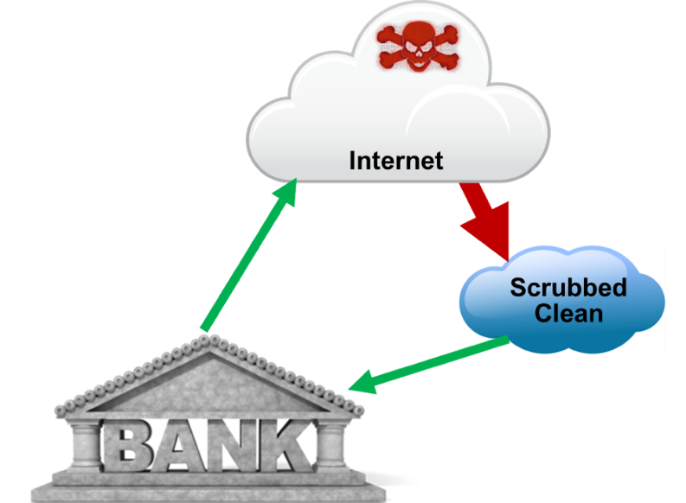
DDoS: Containment, Eradication, and Recovery
Automated systems make all the difference.

Slide 146
Post-Incident
Incident report
Classification of the attack
Source
Detection
Mitigation
Recommendations
Communications
Who needs to be informed?

Slide 147
Unusual Activity on a Laptop
The audit system has detected the audit log has been disabled on a laptop, the cause for the change is unknown
What steps should follow?

Slide 148
Forensics

Slide 149
Activity: What Questions Would You Ask?

Slide 150
Summary
Described the key components of incident response
Discussed the integration of forensic analysis into the incident response procedures
Examined two incidents and discuss the response

Slide 151
Demilitarized Zones (DMZs)
Chapter 10

Slide 152
Objectives
Upon completing this chapter, you will be able to
Understand the concepts and benefits of DMZs
Understand the architectures and implementation of DMZs

Slide 153
Concept of DMZs
Sometimes called the “Perimeter Network”
Separate network for the bank’s publically accessible servers/resources
Email servers
Web servers
FTP servers
DNS servers
Etc.
Advantages
A layer of protection from the untrusted public domain, (i.e., the Internet)
Keeps outside traffic off of the internal protected network

Slide 154
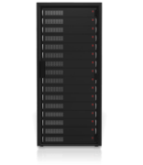

Implementation of DMZs
A network hardware firewall is typically used
In its most simple form, it can be just another Layer 3 port on the firewall
Local Area Network
Public Internet
DMZ Network

Slide 155
Implementation of DMZs (Cont.)
Firewalls built for networks have the extra ports and functionality needed to build a DMZ
Key benefit is the bank can place all the publically accessible resources in the DMZ and make only those IP Addresses available to the public domain
These features do not exist on lower-end routers designed for the SOHO space, as those size users typically host such services with a service provider

Slide 156

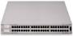
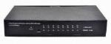


Architectures of DMZs: Example 1
VLANs may be used as well to “imitate” a DMZ, if supported on the firewall
As an example
One VLAN for internal network
One VLAN for DMZ network
Switch
Router
Public Internet
Load Balancer
Database Server
Application Server
Remote Clients
Web Farm

Slide 157

Architectures of DMZs: Example 2
DMZ is wedged between two firewalls
Maybe of differing manufacturers
Internal network and access to service providers, (FISERV, etc.) is protected
SQL Server
Service Providers
Firewall
Firewall
Router to External Network
DMZ
Internal Network
Service Consumers

Slide 158

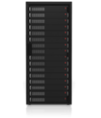
Architecture: Example 3
The DMZ hardware may be a Layer 3 component
There will be switches providing the Layer 2 transport
DMZ consists of
Firewall(s)
Servers
Switches
Possibly VLAN’s implemented
Firewall 1
Firewall 2
Router
Public Internet
Hub or Switch
Hub or Switch
Private Network
DMZ Zone
Public Web Server
Public Mail Server
Server

Slide 159

Areas to Investigate with the Bank
Do you have a DMZ?
Who manages it?
What resources lie in the DMZ?
Is it done with VLANs or discreet ports?
Where do these resources reside?
Email servers
VPN servers—concentrators
FTP servers
DNS servers
Remote video monitoring servers
Web servers

Slide 160
Summary
Discussed the concepts and benefits of DMZs
Discussed the architectures and implementation of DMZs
Key take-aways
When perimeter network/DMZ capabilities are not available on a firewall, beware
This would usually force servers to be placed on the internal network, and rules would have to be configured to allow access to these servers
This type of setup can be very dangerous because a company would have ports and IP addresses open on their internal network accessible via anyone from the outside world
Hackers can attempt to access network resources via these public servers

Slide 161
Packet Filters
Chapter 11

Slide 162
Objectives
Upon completing this chapter, you will be able to
Describe packet filtering
Explain the use of access control lists
Provide examples of stateful inspection
Describe how a bank might use packet filtering

Slide 163
Packet Filtering
Permit or Deny Passage
Inside
Outside
IP
TCP/UDP
APPLICATION DATA

Slide 164
Inbound Packet Filtering
Web
Server
allow http
to 64.13.12.57
block everything else
DNS entry points to the web server for www.anybank.com at: 64.13.12.57

Slide 165
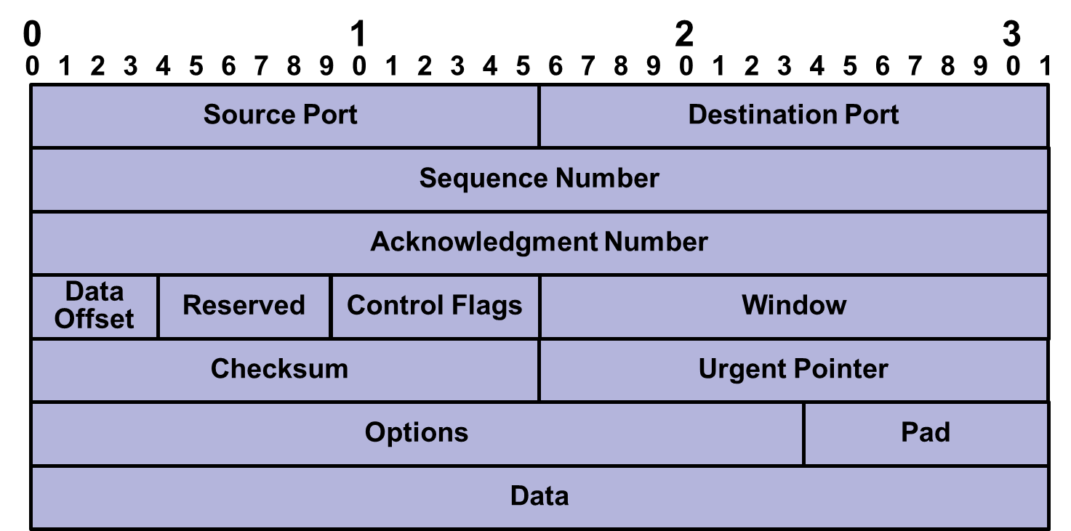
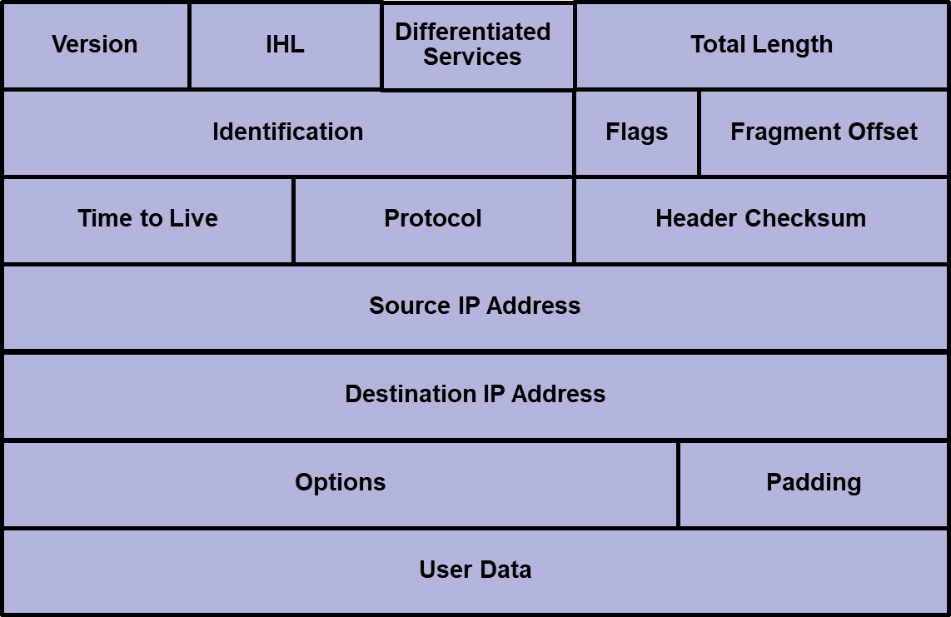
How Do We Know What to Block?
TCP
allow http
to 64.13.12.57
IP

Slide 166


The Rules In Action
Web
Server
syslog entry

Slide 167

Outbound Rules
Rules likely to be different to inbound
Vendor may support global rules that apply to outbound and inbound traffic
So what might we block outbound that we may allow inbound?

Slide 168
Port Addresses
Port | Protocol | Port Name (Function)
20 | TCP | ftp-data (File Transfer Protocol data channel)
21 | TCP | ftp (File Transfer Protocol control channel)
22 | TCP | ssh (Secure Shell Protocol)
23 | TCP | Telnet
25 | TCP | smtp (Simple Mail Transfer Protocol)
53 | TCP; UDP | domain (Domain Name System information)
69 | UDP | tftp (Trivial File Transfer Protocol)
80 | TCP | http (HyperText Transfer Protocol)
110 | TCP | pop3 (Post Office Protocol)
119 | TCP | nntp (Network News Transfer Protocol)
123 | TCP | ntp (Network Time Protocol)
143 | TCP | imap4 (Internet Message Access Protocol)
161 | TCP | snmp (Simple Network Management Protocol)
443 | TCP | https (HyperText Transfer Protocol Secure)
Port addresses may be used in ACLs
What protocols might you block inbound and outbound?
In chapter 1 we used ping and tracert what rules might you put in place for ICMP that is used by the applications?

Slide 169
What Does This Inbound ACL Tell Us?
allow http 64.13.12.57 any
allow smtp 64.13.12.58 any
allow 53 64.13.12.59 any
block 23 64.13.12.60 any
allow 23 64.13.12.60 64.13.12.24

Slide 170
ACLs
Format varies by vendor
Some common characteristics
Resources can be named and grouped
Rules can be applied to one host, a range of addresses, a group, or everyone
Rules usually processed sequentially, so order matters
May be time-based

Slide 171
TCP Connection States
Normal TCP operations starts with establishing a connection
Remember the combination of IP address and TCP connection is a socket
Packets in a TCP connection have sequence numbers
Used in acknowledging receipt of information
To detect missing data
SYN
SYN, ACK
ACK

Slide 172

Stateful Example
Outbound Rule
allow http any any
Inbound Rule
block http any any
Source Address | Source Port | Destination Address | Destination Port | Status
64.13.12.34 | 1030 | 164.34.28.11 | 80 | Established
64.12.13.57 | 1890 | 173.194.207.101 | 80 | Initiated

Slide 173



Why Should a Bank Use ACLs?
Privileged
Machine
Open
Zone
Secure
Zone
Low
Privileged
Machine
Server

Slide 174
Some Final Considerations
ACLs and packet filtering are only one measure that should be taken
Firewalls often contain many other capabilities
NAT/PAT
VPN
Outbound ACLs will be applied after the other functions
Threat signatures are constantly changing and becoming more complex and multi-faceted
Unified Threat Management provides a more complete approach

Slide 175
Summary
Described packet filtering
Explained the use of access control lists
Provided examples of stateful inspection
Described how a bank might use packet filtering

Slide 176
Unified Threat Management
Chapter 12

Slide 177
Objectives
Upon completing this chapter, you will be able to
Understand what UTM is
Understand the benefits of UTM
Understand the various components which comprise UTM solutions
Examine UTM in a banking environment
Look at UTM deployment alternatives

Slide 178
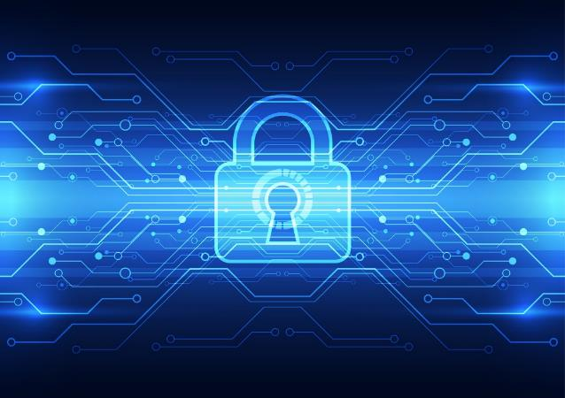
Unified Threat Management
“All-in-One” security appliance
Is needed due to the ever growing
Number of threats
Complexity of threats from the Internet
Firewalls can only do part of the job today
Reduces the number of “boxes” to be managed, but not the number of functions
Simplifies the effort through common interfaces etc.

Slide 179

UTM’s Common Security Elements
Here is a list of some common security protection elements supported in UTM today
IDS/IPS
Zero Day Protection
DoS and DDoS
Application Proxy Filtering on the Application Layer
Spam Filtering
URL Filtering
Anti-Phishing
Anti-Spyware
Rootkit Protection
NAC
VPN

Slide 180






UTM Players and Market
Manufacturers
Watchguard
Fortinet
Plus others
Market
Small to medium-sized banks would be the “hot” spot due to granularity
Not as much flexibility from an all-in-one box as opposed to individual boxes
Larger banks typically have individual components or maybe a blend of UTM and individual elements depending on their need
Performance is a factor
The more options turned on the greater the effect on throughput
Merger and acquisition activity may affect performance and security if growth is not factored in

Slide 181

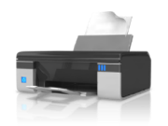

Sample Deployment Diagram
Notice where the UTM platform lies
UTM
Internet
Firewall
Anti-Virus/ Spyware
Anti-Spam
Intrusion Prevention
Monitoring and Reporting
Content Filters

Slide 182

Topics for Consideration with UTMs
We will look at each of these in greater depth going forward
Is its performance scalable?
What services and technologies are included?
What network features does the platform support?
Is it IPv6 ready?
Can VLANs be supported?
Is it survivable, can it be high availability (H/A) supportive?
Does it integrate with or contain any management reporting?

Slide 183

Is it Performance Scalable?
Speeds keep increasing
Can the platform grow as well?
100 Mbps → 1 Gbps → 10 Gbps, etc.
Best designs are those that are modular and integrated
Bank should have looked at independent product assessments from third party groups like
ICSA Labs
NSS Labs
Gartner

Slide 184
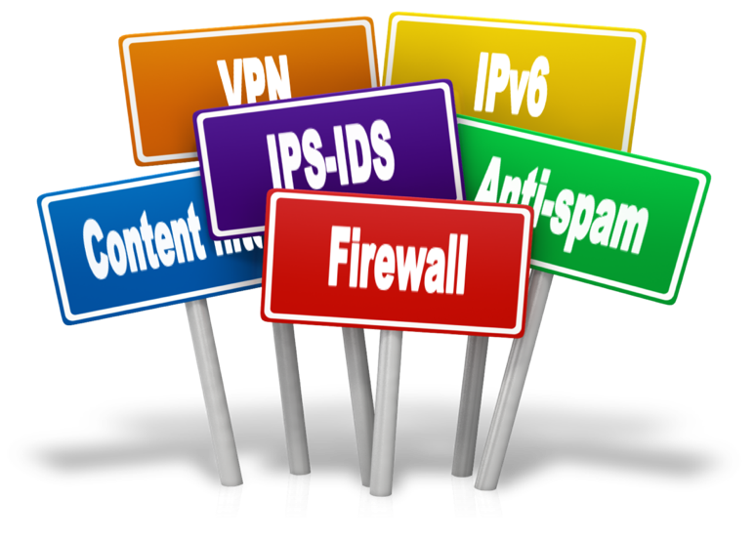
What Services and Technologies are Supported?
Well rounded protection should include at a minimum
Firewall ✓
Application control ✓
IPsec and SSL VPN ✓
IPS - IDS ✓
Web content filtering ✓
Anti-spam ✓
Data loss/leakage protection ✓
Anti-virus and anti-spyware protection ✓
IPv6 native support ✓
Traffic shaping/bandwidth control ✓

Slide 185
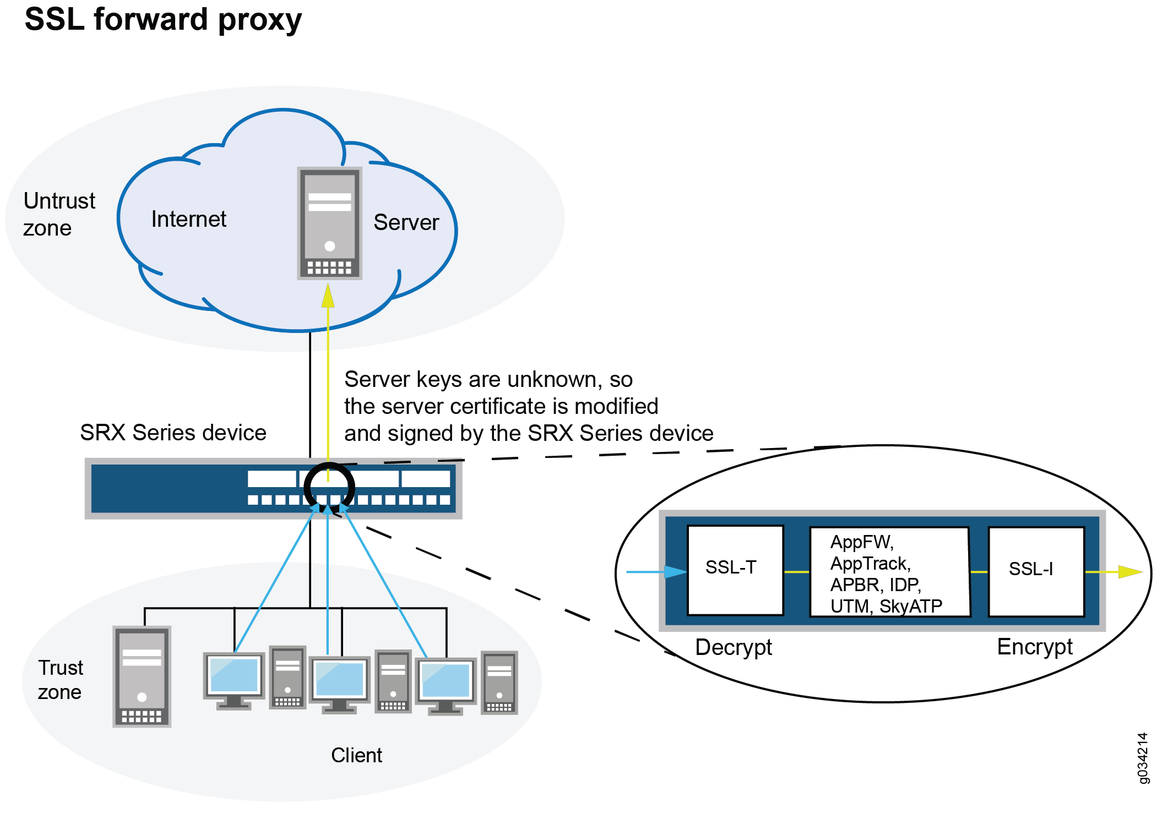

Slide 186
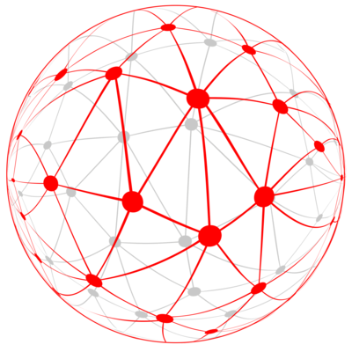
What Network Features are Supported?
Network management
IT dashboards
Varying WAN technologies
Wireless integration
Even if not used today the bank may have these capabilities as part of a growth strategy

Slide 187
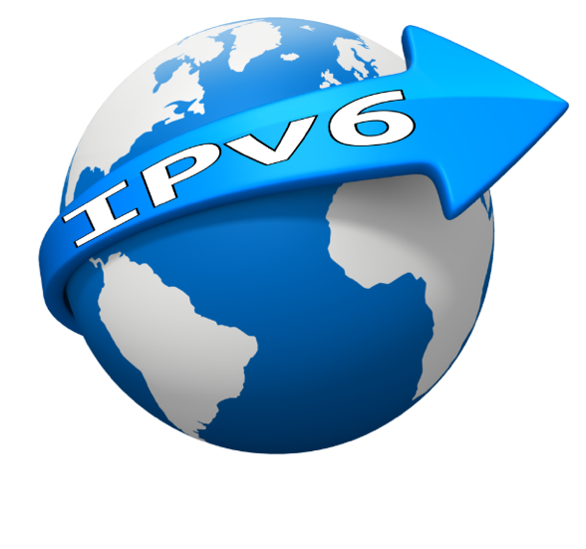
Is it IPv6 Ready?
Address exhaustion is a driver
Not a question of if, but when
Any IPv6 concerns?
Does the bank’s UTM inspect the IPv6 traffic, or just pass it along?
Can it support IPv6 related routing protocols
RIPng
OSPFv3
BGP4+

Slide 188
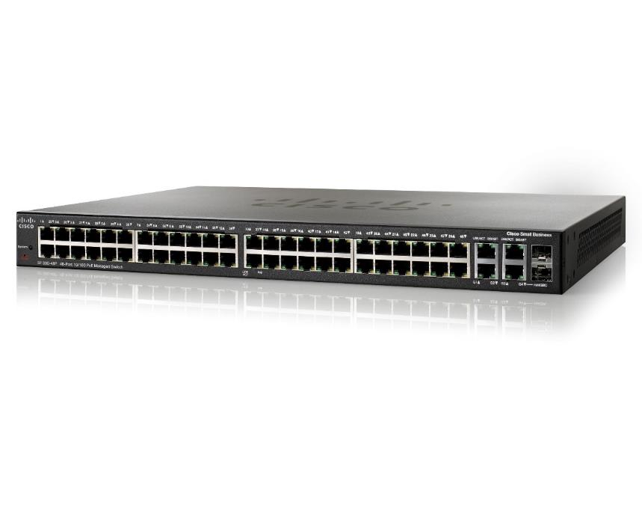
How are VLANs Supported?
VLANs and VDOMs
They are there for security reasons
Does the UTM platform support them?

Slide 189

Is it Survivable?
Active-active
Active-passive
Load balance
Clustering
H/A with Multihoming

Slide 190

How is UTM Managed?
Does it integrate with the bank’s NetMan platform?
Does it have its own management platform?
Can the policies be integrated in a single profile metric?
IPS
Web filtering
IDS
Becomes easier and less fraught with potential error
Best models have the following features
Consolidated management
Advanced management
Centralized management

Slide 191

UTM Final Thoughts
Properly evaluated and deployed, a UTM system can yield multiple benefits to a bank's security. UTMs offer consolidated reporting on the state of a network and associated infrastructure.
Normalizing data and management remain a responsibility of the bank and although difficult, is eased a bit via UTM
Small to medium-sized banks are probably served the best

Slide 192
Summary
Looked at the concepts behind UTM
Discussed the benefits of UTM
Examined several options that exist for UTM’s
Examined UTM in a banking environment
Looked at UTM deployment alternatives
Key take-aways
UTM’s can be very sophisticated but actually designed to reduce management load when compared to individual components
Management is still needed
It could be a single point of vulnerability if not managed and secured well
Our task at a minimum is to determine
Who owns it?
Who manages it?
What policies exist for its operation and how consistent are they?

Slide 193
The Future of Firewalls (and this of class!)
Perimeters
A classic firewall protects the network perimeter. Even if it’s a best-in-class NGFW or UTM box, is that good enough?
Zero-Trust Network Architectures (ZTNA)
We’ve done some reading and talking about this, is it the future of network security? Don’t banks need to adopt this kind of thinking?
Secure Access Service Edge (SASE)
As with ZTNA, SASE would seem to be an obvious future direction for banks.
Changing bank network architectures
When everything’s in the cloud, doesn’t that change everything?
Does it make things better or worse from a security point of view?

Slide 194
Talking to Banks about their Firewalls
Question anything you don’t understand
Ask them to explain their diagrams and/or ACLs
What kind of box is this, what does it do?
Is this “firewall” actually a UTM appliance?
What services are configured on it?
What cloud services inform or empower it?
Are there offsite services involved beyond the firewall?
Is security provided by other devices?
Bank people may not always have good answers
You may need to involve outsource personnel
How hard do you want to dig?
These tips will be even more important in the future!

Slide 195
Exercise: Bank Firewall Topologies
Each bank in the exercise has unique goals and poses unique risks
Your bank is considering a new security platform, and perhaps a new network plan
Your job is to draw an initial design for this
Questions to ask:
Where should the firewall(s) or other appliances go?
Does your bank have internet, a WAN, or both?
Where is your bank’s main data storage?
Where and how are service providers accessed?
How are firewall management issues addressed?
How might the network change in the next 5 years?
Could zero-trust considerations me made?
Banks in Contention:
1: TinyBank USA
3: Big Ambitions Bank
2: vBank
4: Almost Regional Bank
5: MNA Bankcorp

Slide 196
Exercise: Bank Firewall Topologies
Bank | Assets | Office(s) | Infrastructure | Strategy
TinyBank | $500M | One storefront location | Single data closet | Please let us stay small!
Big Ambitions | $2B | HQ and 2 branches, one more being built | Server room in HQ, two branches connected via VPN | Next stop $10B baybay!
vBank | $5B | 20 cubes in an office block | Entirely Virtual and in the cloud. | Tech will make us win.
Almost Regional | $11B | 5 offices (one is HQ) and a data center | Must have WAN bandwidth to grow. | Land and expand, it’s all about growth.
MNA Bankcorp | $8B | A bank and B bank are merging. | Two IT teams duke it out, may the best win. | Together we’ll change the world!

Slide 197
Exercise: Bank Firewall Topologies
The intent here is to consider these ideas, not to design a perfect bank branch network. Don’t stress it too much!
Ideally your team will produce a diagram based on mine that that shows:
How the network is arranged – not much detail required
Where various resources and zones exist
Where the firewalls or UTM or whatever goes
Ideally you’ll also be able to talk about what you did and why
This is more a working discussion with a drawing than an assignment
There are many ways to approach the problems here, so again, no pressure is implied or expected! There are many right answers here.

Slide 198
Emerging Technologies

Slide 199
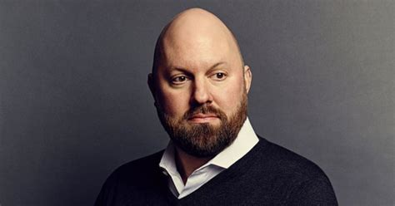
Software Eats the World
Marc Andreesen (Netscape, Andreesen Horowitz)
Every device, appliance or box in this course is going away or being consolidated with others
They are being replaced with software running on:
General purpose silicon (CPUs)
Graphics processors (GPUs)
Embedded Devices
Almost everything else (IoT, appliances, smart devices)
This trend is not confined to networking!
Read about the current microchip shortage
What parts of your phone require special hardware?

Slide 200

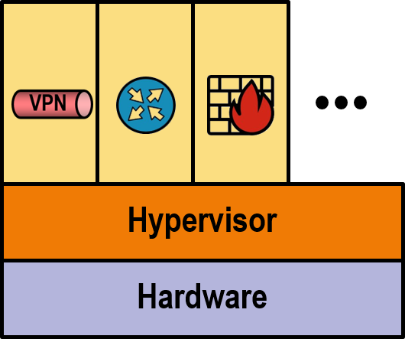
Firewall Virtualization
Applies virtualization concept to network function (NFV)
One piece of hardware (universal CPE), replaces multiple proprietary boxes
Supports multiple network functions (VNF) in software
All controlled/maintained centrally

Slide 201




Hybrid SD-WAN
SD-WAN overlaid on existing MPLS network
Corporate Hosted
Applications
Applications Needing
Private Connections
MPLS
Branch Site
Cloud and Internet
Applications
Data Center
Internet
Cloud
Applications

Slide 202
Pure SD-WAN
Multiple (diverse) Internet connections
Corporate Hosted
Applications
ISP 1
ISP 1
ISP 2
ISP 2
Internet
Branch Site
Wireless
ISP
Wireless
ISP
Data Center
Cloud
Applications

Slide 203

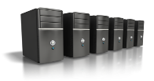

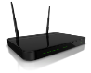
Virtual Machines Benefits
Application
Application
Application
Operating System
Operating System
Operating System
Virtual Machine
Virtual Machine
Virtual Machine
Virtual Infrastructure
Servers
Storage
Network
Network
Storage

Slide 204
Cloud Services
Moving applications and/or infrastructure to an external data center owned and run by a third party
Various services are available
Infrastructure as a Service (IaaS)
Platform as a Service (PaaS)
Software as a Service (SaaS)
Storage as a Service (SaaS)
Desktop as a Service (DaaS)
Communication as a Service (CaaS)
Everything as a Service (XaaS)
Virtualization technology has made cloud services cost effective versus hardware and/or software ownership
Security is sometimes raised as a concern for cloud services

Slide 205

Cloud Models
Cloud services come in three variants: public, private, and hybrid
Many organizations use cloud services for select applications
Over time more applications move to the cloud
Private
Internet / public
Hybrid

Slide 206






The Software-Powered Cloud Changes Everything
This plus massive compute = cloud computing wins every race.
Economies of scale make computing incredibly cheap (and profitable.)
Security and privacy are just tricky but solvable computing problems.
Who really must still run their own data centers? Really?
US DOD is a huge customer of GCP, AWS, Azure. Privacy is solved.
Infrastructure as a service (IaaS) has progressed.
Through Platform as a Service (PaaS) to Software as a Service (SaaS).
Layers of abstraction mean that whole systems can be simulated.
Virtual machines, Containers, Kubernetes are the new “infrastructure.”
“Serverless” applications means users need only know their apps.
Notes:
https://a16z.com/2011/08/20/why-software-is-eating-the-world/
https://www.informationweek.com/cloud/cloud-computing-2019-the-cloud-comes-of-age/d/d-id/1333442

Slide 207
Not just Much Cheaper, the cloud is Much Better.
21st Century bank IT To-dos:
Build new data center.
Buy and deploy new servers.
Acquire offside DR location.
Reinvent the wheel. Again.
Take an application-focused approach.
Support innovation for the bank.
Access the same tools as the big guys.
Use data to remain competitive.
Lower expenses, owned>hybrid>public.
Improve and secure network access.
Performance, Business Continuity, and Disaster Recovery can all be improved by a cloud approach.
Geographic diversity, fate-sharing, availability risk of all kinds is well-addressed in the hyperscale clouds.
Things better centralized, like compliance, become much easier with a single point of access.
The advantages are worth the risks (to most.)
Security is still a concern, but being addressed by advances in e.g. authentication and encryption.
More comprehensive, better correlated customer data can improve outcomes for banks and customers.
These benefits come with a new reliance on the network.
Which is why telecom and data communications are such important topics for banks and regulators.
Notes:
https://www.networkworld.com/article/3296366/assuring-the-future-of-financial-services.html
https://thefinancialbrand.com/77228/technology-trends-disrupting-financial-services-banking-future/
http://www3.weforum.org/docs/WEF_The_future__of_financial_services.pdf

Slide 208







Banking and Cloud Economics
Even the conservative banking sector is yielding to financial reality.
Lower operational expense is the initial draw in many cases, but agility, elasticity, better data correlation all await cloud implementers.
Ultimately even small banks face issues of competitiveness and even survival.
Fintech is in rapid cloud evolution for core processors and everyone else.
Finastra’s deal with IBM for cloud-based core functions.
Jack Henry offering a Gladiator private banking cloud as a service.
Many other moves outside the traditional spheres of banking.
Access to Machine Learning and other analysis for even smaller players.
Who will take on the big players to keep their business local?
Functions outside core are already overwhelmingly cloud-provided
Sales: Salesforce SaaS, Hubspot, Zoho, Agile CRM.
HR: PeopleSoft, APS, Ceridium, Gusto, Zenefits.
Office Productivity: Microsoft Office 365.
Notes:
https://www.zdnet.com/article/the-top-cloud-providers-for-financial-services/ (old)
https://biztechmagazine.com/article/2018/08/what-are-benefits-cloud-based-core-banking-solution
Last year, Finastra, the company formed by the merger of the bank-technology vendors D+H and Misys, announced it would run a digital banking and core processing platform in IBM’s cloud. Public cloud providers can provide scale and security for banks.
https://www.profitstars.com/information-security-and-risk-management/gladiator-network-services/pages/gladiator-hosted-network-solutions.aspx

Slide 209
Bank Network Futures

Slide 210




Core Processing in the Cloud
Historically, Core Processing was owned by a handful of specialized companies
Moving to the cloud poses both advantages and risks for core processors
Fintech solutions can rapidly add new capabilities and change what “core” means
Will the cloud come to the core before the core comes to the cloud?

Slide 211
Network Talent and Trust as Risks
As network service become more powerful, they become more complex
Management software and AI should make things easier
But understanding and trusting solutions is still important
What happens if the one person at the bank who understands the network quits?
What happens if the bank can’t trust an outsourcing provider?
Education
Certification
Standards
Cross-training
Knowledge in Depth
Outside opinions
What else?

Slide 212
Community Bank Innovation
Small banks are conservative followers, right?
They better not be, or they will lose!
Many big bank tools are available to all banks
Big Data
Artificial Intelligence / Machine Learning
Modern tools + personal service
The speed and capability of these depend on the network

Slide 213
Thus Endeth the Lessons
Congratulations on a completing a big three days!

Slide 214

Thank You!
Matt Kolon
matt@hillvt.com
(802) 899-0704
I’m @boingit on Telegram
I’m also on Strava, I’ll follow you back! ☺
And there’s always LinkedIn…
The class.hillvt.com site will be up for a couple weeks at least

Slide 215
Who We Are
At Hill Associates, we excel at creating custom talent development programs. Our experts help identify and assess your needs, and create training and educational programs that exactly meet those needs. Though we specialize in information technology, we’ve strengthened companies and organizations in a wide range of industries for over 30 years. Let us help you create a world-class talent development program that moves your business forward.
Hill Associates, Inc.
PO Box 9
Milton, VT 05468
+1.802.655.0940

